Slide 1
Section 7.1 What is Probability?

Slide 2
What is Probability?
Probability is the likelihood/chances that an event or a series of event would occur
A probability of 100% or 1.00 would mean that the event will happen for sure
In contrast, a probability of 0 would mean that the event will NOT happen
When calculating probability of an event, it is important to look at all the outcomes that are possible!!
IF everyone outcome is equally likely to occur, then the probability of an event will be:
Note: The probability of each outcome must be equal
If the events are NOT equally likely, we would need to use one of the following to calculate probability of an event:
TREE DIAGRAM
BINOMIAL DISTRIBUTION FORMULA

Slide 3
Common Terms: “Outcomes” and “Events”
An outcome is the result from a single trial of an experiment
If your experiment is rolling a die [one dice], your outcomes would be: 1, 2, 3, 4, 5, and 6
If your experiment is flipping two coins, your outcomes would be: HH, HT, TH, and TT
The probabilities of each outcome do NOT have to be equal but they should all add to 100%
An event can be a single outcome or a set of outcomes
EVENTS can be the following:
the event of rolling an even number {2,4,6}
a number less than 5 {1,2,3,4}
a prime number {2,3,5}
rolling a 4,...etc
Since the outcomes are equally likely, you can add the probabilities of the outcomes to get the probability of the events

Slide 4
Practice: Calculate the probabilities of each outcome and event
a) When flipping two coins, what is the probability of getting atleast two heads
b) When rolling a die, what the is probability of getting a prime number?
c) When rolling a dice and flipping a coin, what is the probability of getting a 2 or 3 and then flipping a heads?

Slide 5
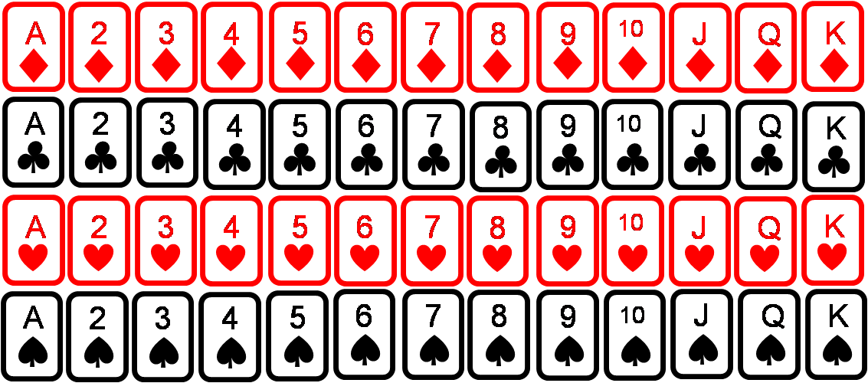
Common Terms: Sample Space
Sample Space: a list of all the outcomes from an experiment. A sample space is useful for calculating the probabilities of outcomes and events if all outcomes are equally likely to occur
Ex: Find the sample space for each of the following experiments:
Flip a coin
Roll a dice
Picking a card from a deck
The sum from rolling 2 dice
A letter is chosen from the word: CHICAGO BULLS

Slide 6
Calculating Probabilities when outcomes are NOT equal
When outcomes are not equally likely, we need to list them all out
Ie: When picking a letter from the name CHICAGO BULLS, what are the probabilities of picking a “B” vs a “C” ?
You have 11 letters that can be picked, and some appear more than once. The probability of selecting these letters will be greater!
Sometimes it is helpful to create a tree diagram to illustrate the number of pathways or outcomes of an experiment with multi-steps
© Copyright all rights reserved to Homework depot: www.BCMath.ca

Slide 7
Ex: 4 coins are tossed, what is the probability of getting 2 or more heads
1st Coin
2nd Coin
3rd Coin
4th Coin
There are 16 different outcomes.
Each branch is a separate outcome
Here’s a list of all the outcomes
HHHH
HTHH
THHH
TTHH
HHHT
HTHT
THHT
TTHT
HHTH
HTTH
THTH
TTTH
HHTT
HTTT
THTT
TTTT
© Copyright all rights reserved to Homework depot: www.BCMath.ca

Slide 8
Practice: a card is chosen from a deck of 52 cards. What is the probability of getting each of the following events?
© Copyright all rights reserved to Homework depot: www.BCMath.ca

Slide 9
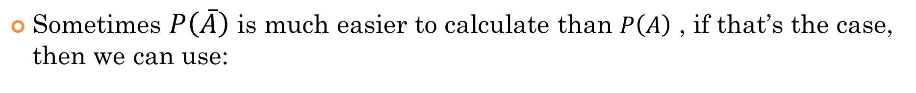
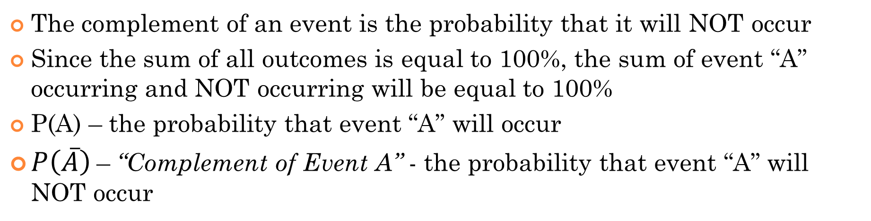
Calculating Probabilities using Complements
The complement of an event is the probability that it will NOT occur
Since the sum of all outcomes is equal to 100%, the sum of event “A” occurring and NOT occurring will be equal to 100%
P(A) – the probability that event “A” will occur
$P\left(\overline{A}\right)$– “Complement of Event A” - the probability that event “A” will NOT occur
Sometimes $P\left(\overline{A}\right)$ is much easier to calculate than $P\left(A\right)$ , if that’s the case, then we can use:
© Copyright all rights reserved to Homework depot: www.BCMath.ca

Slide 10
Practice: When flipping a coin 8 times, what is the probability of getting 1 to 7 heads? Ie: getting 1 head, 2 heads, 3 heads, ….. Or 7 heads?
For this question, try to get the complement of the event that you are calculating.
Getting 1 to 7 heads means that you can’t get: i) NO heads and ii) ALL heads
2 x 2 x 2 x 2 x 2 x 2 x 2 x 2 = 128 we have 128 different outcomes and there’s only 2 outcomes that have either all or no heads: TTTTTTTT and HHHHHHHH
b) When rolling 5 dice, what is the probability of rolling at least one 6? Ie: you must have at least a 6 in the five rolls.
The complement of getting atleast one 6 is getting NOOOO 6’s.
The total number of outcomes = $6^{5}$
Number of Complement outcomes = $5^{5}$

Slide 11
Probability with Permutations & Combinations:
When solving probabilities using counting principles, the probability of each outcomes MUST be equally likely involved:
If we are finding the probabilities of 5 card hands, every hand is equally likely b/c we are randomly drawing 5 cards from a deck
Ex: What is the probability of being dealt the following five card hands?
a) Flush with spades
b) Full house with 3 kings and 2 aces
© Copyright all rights reserved to Homework depot: www.BCMath.ca

Slide 12
Ex: Four cards is drawn from a deck, what is the probability of not getting any diamonds?
b) What is the probability of getting atleast one diamond?
39 cards that are not diamonds
Choose 4 cards from a deck of 52
Use the complement to find this probability:
© Copyright all rights reserved to Homework depot: www.BCMath.ca

Slide 13
Practice: What is the probability of getting a five card hand with 3 hearts and 2 spades?
b) What is the probability of getting a seven card hand with 4 red cards and 3 spades?
c) What is the probability of getting 4 spades, 2 hearts, and 1 club from a 7 card hand?
Use the bucket method to find the total number of desired hands
© Copyright all rights reserved to Homework depot: www.BCMath.ca

Slide 14
Ex: There are 12 horses in a race with 1st, 2nd, and 3rd places. What is the probability that someone will get all three horses in the correct order?
Only 1 correct outcome
Order matters, so its a permutation
Practice: if the order of the horses is not taken into account, what is the probability that someone will correctly get all three horses?
Only 1 correct outcome
Order doesn’t matters, so its a combination
© Copyright all rights reserved to Homework depot: www.BCMath.ca

Slide 15
In the Lotto 649 draw, 6 numbers are drawn from 1 to 49 without replacement. What is the probability of each event?
a) Four out of six numbers are correct
b) Five out of six numbers are correct
Out of the 6 numbers you chose, 4 of them are correct
43 other numbers that you didn’t choose, 2 of them were in the lottery
Order doesn’t matters, so its a combination
© Copyright all rights reserved to Homework depot: www.BCMath.ca

Slide 16
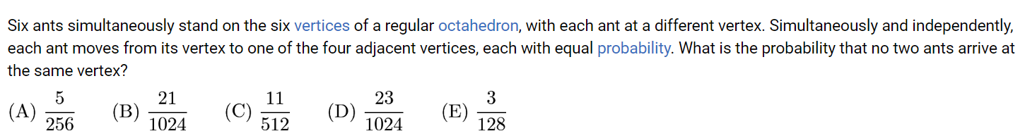
Use the middle plane (ABCD) as the center and basis of your solution:
Split the ways that the ants can move into separate cases:
In all the cases, “F” must choose a point to go down to and “E” must choose a point to go up to:
Case 1: “F” Down, “E” up, the other two switch
Case 2: “F” Down, “E” up [loop], the other two switch
Case 3: Make two triangles, TOP/BOTTOM
Case 4: Make two triangles, adjacent triangles
Case 5: Giant Loop

Slide 17
Case 1: “F” Down, “E” up, the other two switch
Ie: “F” <->”D” and “E” <->”C” and then A-B switch
The two points that switches with “F” and “E” must be adjacent, otherwise the other two can’t switch
Case 2: “F” Down, “E” up [loop], the other two switch
Ie: “F” → D → “E” → “C” → F , the other two switch
The two points in the middle chosen for the loop must be adjacent so that the other two can switch

Slide 18
Case 3: Make two triangles, TOP/BOTTOM
Make a loop with “”F → D → C” and “E → A → B”.
Each loop can be CW or CCW
When choosing the triangles, they need to be on opposite sides, so that they don’t have any common middle points
#of ways to pick the triangles
# or directions
Case 4: Make two triangles, (loop & Switch) Adjacent triangles
Create a loop with the points from the two triangles. The other two remaining points will switch
Ie: “E → C → B → A → E” and then “F & D” switch
The loop can be CCW or CW, the two adjacent triangles can be TOP/BOTTOM

Slide 19
Case 5: Giant Loop
The giant loop should contain all the points and this case is the hardest to count
Start from the TOP at “F” and go through an example
To count the number of pathways here, make a tree diagram

